Slide 1


Solar
Alliances
Expand your Horizon
Milestone 2 Delivery

Slide 2


Personal introduction
Leon Micheel-Sprenger
Sofia Ferreira

Slide 3
Introduction to the Game
Title: Solar Alliances
Genre: Strategy & Management
Art: 2D
Platform: Computer Browser
Gametype: Multiplayer Game
Audio:
Subtle Space background sound within main Menu
Energetic background music for marketplace
Sound Effects and voice messages for actions taken by player

Slide 4
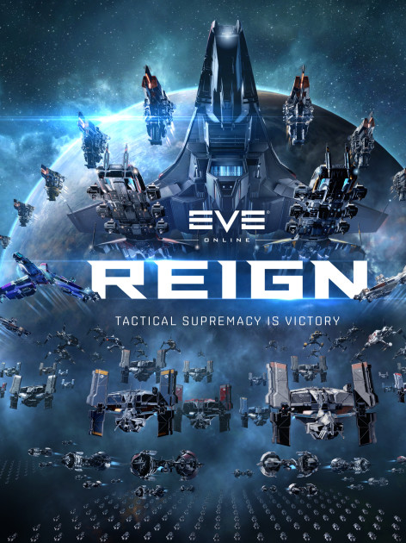
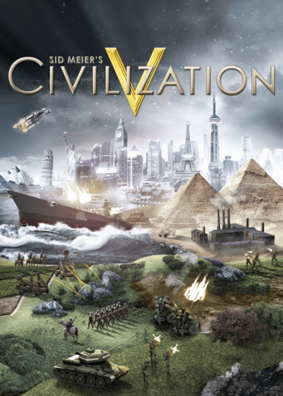



It is the year of 2350. Humankind has evolved and expanded its habitat across the solar system. The formation of new political systems in the system creates a call for new leaders, who must carry the responsibility of an entire civilization on their shoulders. Will you be one of those leaders?
Inspiration
Notes:
Leon

Slide 5
Game Objective
The player is the commander of a space station associated to one of three factions with a fleet of different spaceships at his/her disposal.
The player can:
Carry out Single Player Missions with his Fleet
Upgrade his/her Space station
Join others on Multiplayer Missions
Trade with his/her respective Faction
Goal:
The goal for the player is the expansion of his space station to unlock new ships and go on bigger, exciting solo or multiplayer missions

Slide 6









Current Assets
Ship-Icons
Resource-Icons
Other
War Ship
Money Icon
Rank Icon
Transport Ship
Ore Icon
Exploration Ship
People Icon
Mining Ship
Water Icon
Notes:
Game Presentation Script:
- Register a new Player
- show the starting screen
- explain resource bar
- explain missions interface
- start one mission
-show ship fleet interface
- buy a war ship
- do first dome upgrade
(when time left)
-switch to advanced player
- show how game advanced looks like

Slide 7
Lets jump into the Game…

Slide 8
Thank you for your Attention
Time for Q&A

